Slide 1
Chronic Kidney Disease (CKD) data challenge
Analysis and prediction modelling of CKD stage progression
Yuri Rykov, PhD

Slide 2
Contents
CKD incidence and progression risk factors: rapid literature review and evidence-based theoretical model
Approaches to analysis and prediction
Results of analysis and modeling
Conclusions

Slide 3

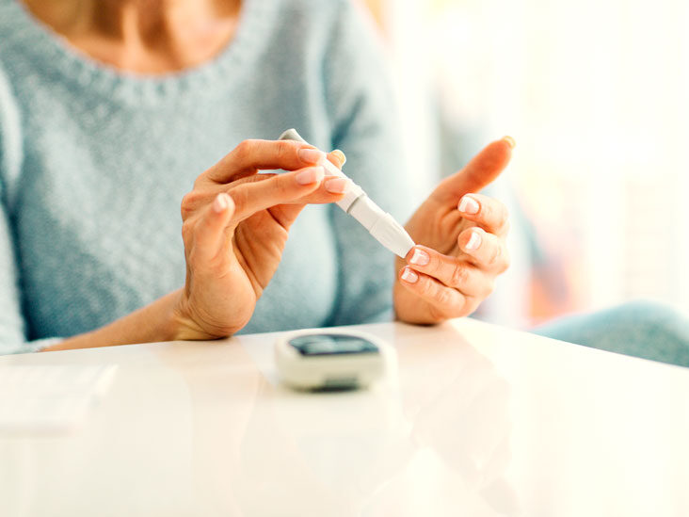

CKD incidence and progression risk factors
Sociodemographic:
Being old, non-white (black/hispanic) and male is associated with higher risk of CKD progression
Physiological and health:
Diabetes (>4-fold higher risk of CKD)
Hypertension (> 3-fold higher risk of CKD)
Anemia (biomarker of CKD preogression)
Dyslipidemia
Impaired kidney function

Slide 4
Rapid literature review and evidence-based theoretical model
What lab tests data do we have?
Biomarker | Health condition
Creatinine | Kidney function
Hemoglobin | Anemia
Blood glucose | Diabetes
LDL cholesterol | Dyslipidemia / hyperlipidemia
Blood pressure (systolic and diastolic) | Hypertension

Slide 5
Approaches to analysis and prediction
Exploratory analysis and visualizations (univariate and bi-variate)
Theoretical/evidence-based feature engineering and model building
Algorithmic machine learning predictive modeling
Mixed effects logistic regression with repeated measures
Bayesian probability estimation and MCMC
Notes:
(1) relatively small sample size and little number of features/biomarkers,
(2) substantial amount of past research and evidence,
(3) strong need in explainable and explanatory models for clinical applications
All these three factors enforce us to try the model-driven approach to prediction in the first place,
and only then once a limitation of predictive power is reached, use more algorithm- and backbox-driven approaches
on top of features and relationships proved in model-driven approach.

Slide 6
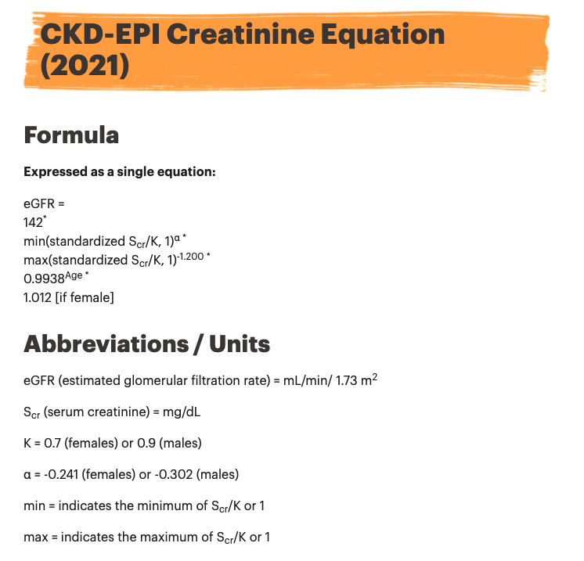
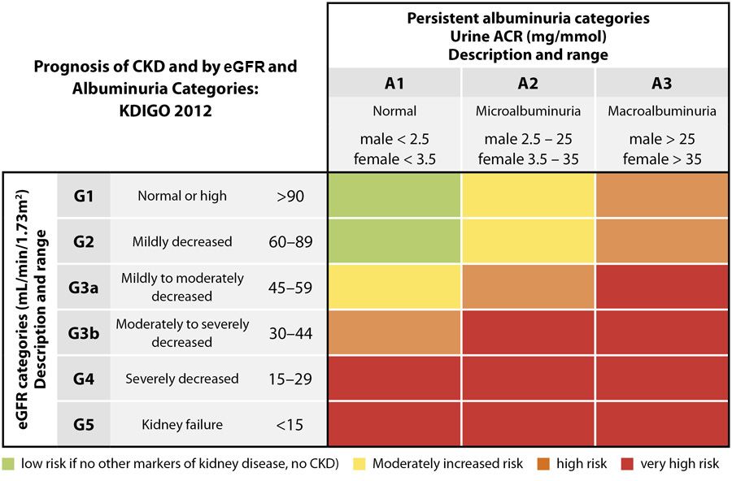
NEW evidence-based feature: Estimated Glomerular Filtration Rate (eGFR) – the key kidney function indicator
Notes:
Eventually, stage progress diagnostics and criteria are based on this biomarker.

Slide 7
Results of analysis and modeling
Exploratory analysis and data processing (standardization)

Slide 8
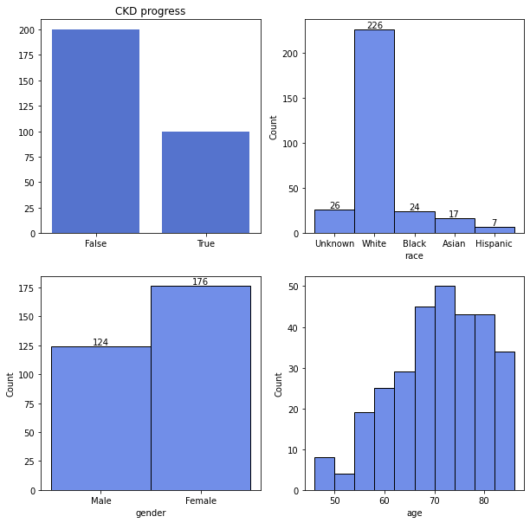
Know your study population: demographics
Race
White 75%
Unknown 9%
Black 8%
Asian 6%
Hispanic 2%
Gender
Female 59%
Male 41%
Age
Mean (SD) = 70.4 (9.2)
Median (IQR) = 71 (14)

Slide 9
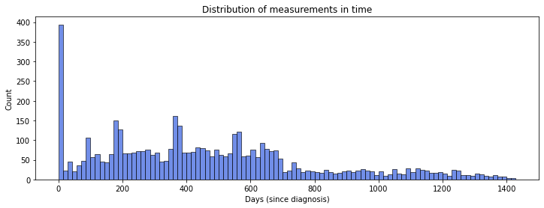
Distribution of measurements [in time]
Lab tests and measurements are non-uniformly distributed in time, yet there are some peaks corresponding to usual appointment schedule: 3, 6, 12, 18 and 24 months after diagnosis/1st visit

Slide 10
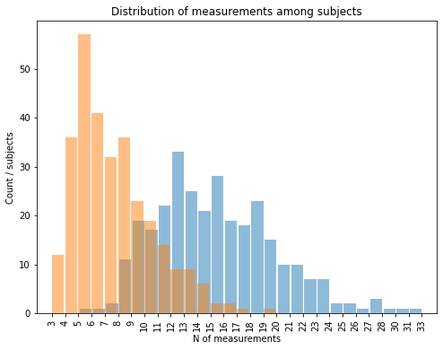
Distribution of measurements [per subject]
N of measurements among subjects
Blue: measurements for all biomarkers
Orange: measurements excluding blood pressure (often are taken outside appointments) and hemoglobin (measures go beyond 2-year timeframe) _______________________________
Two most frequent number of measurements are 5 and 6, that corresponds to observed peaks in time-distribution.
=> all measurements among subjects can be grouped into time intervals corresponding to common appointment schedule
Notes:
It's known that based on the CKD stage the max number of recomended visits are 4 per year, hence time intervals

Slide 11
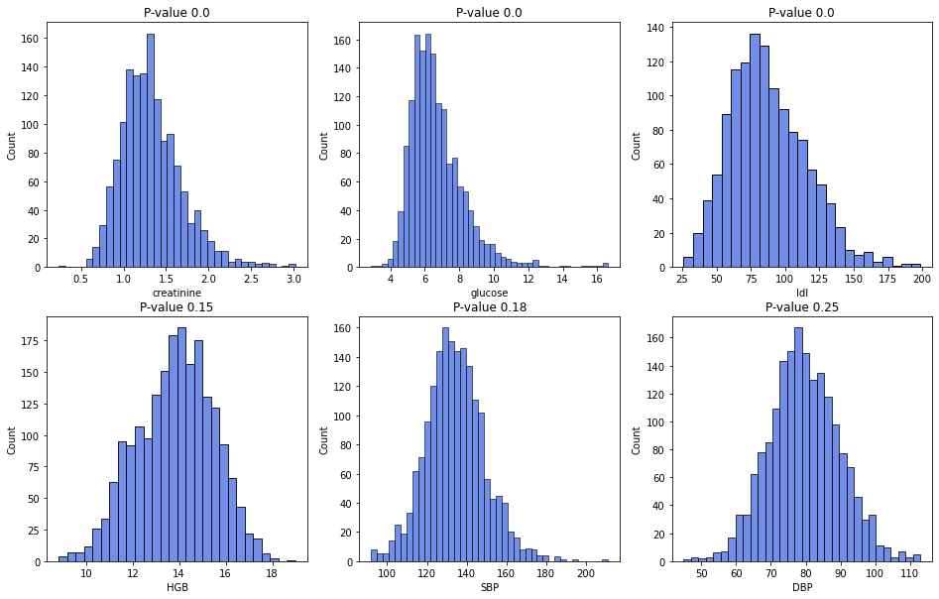
Biomarkers: univariate analysis
Kolmogorov-Smirnov tests show that creatinine, glucose and LDL cholesterol are distributed non-normally (p-value < 0.05)
HGB, DPB and SBP follow normal distribution

Slide 12
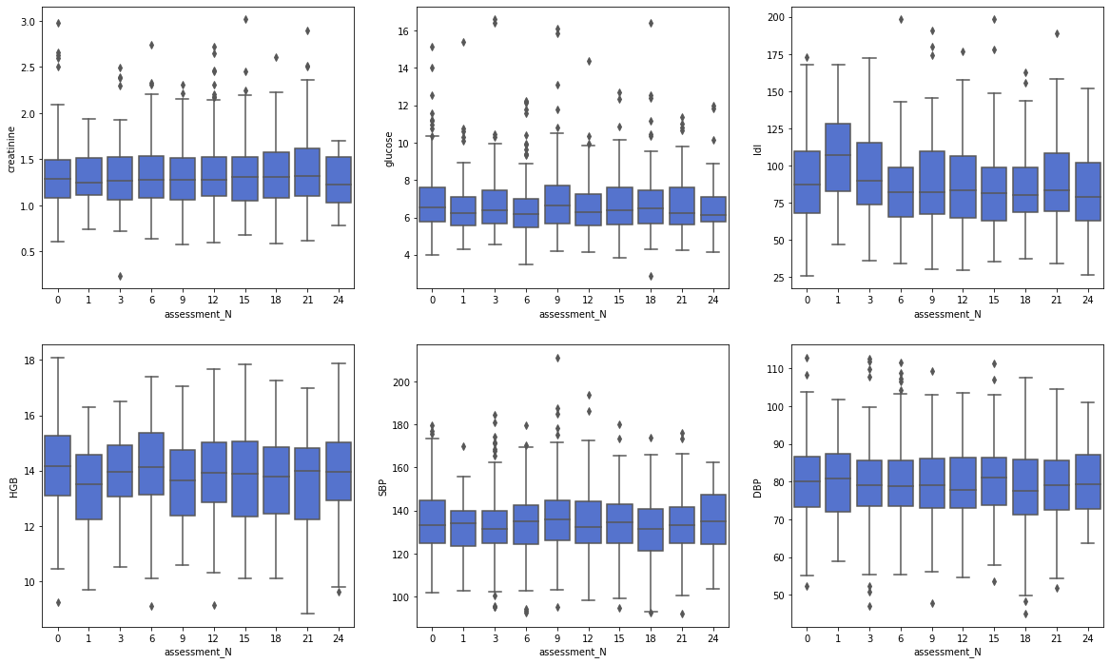
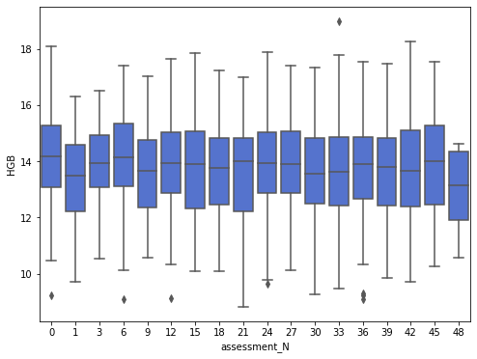
Bivariate analysis: biomarkers ~ follow-ups

Slide 13
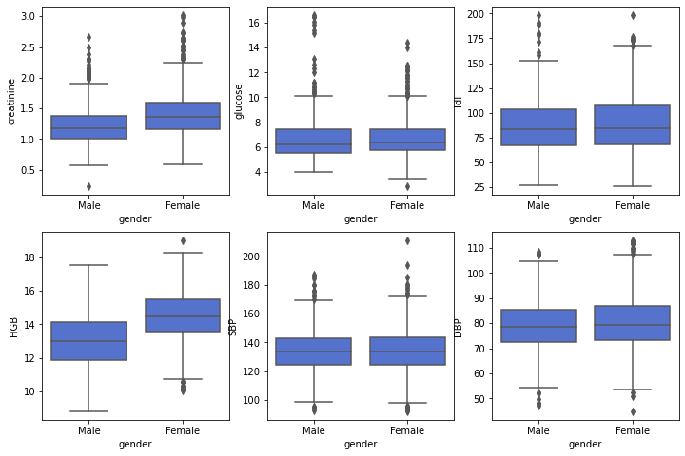
Bivariate analysis: biomarkers ~ gender

Slide 14
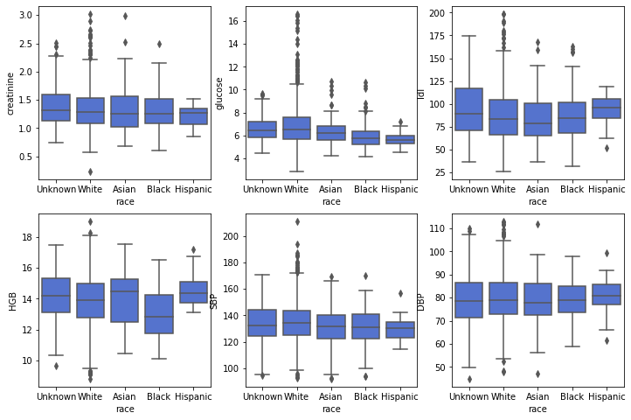
Bivariate analysis: biomarkers ~ race

Slide 15
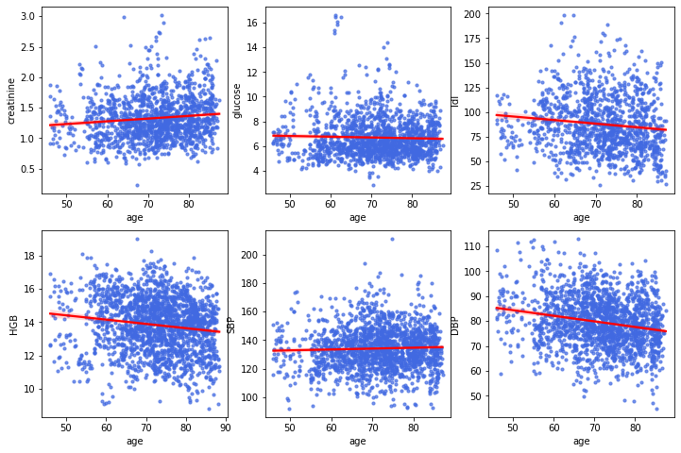
Bivariate analysis: biomarkers ~ age

Slide 16
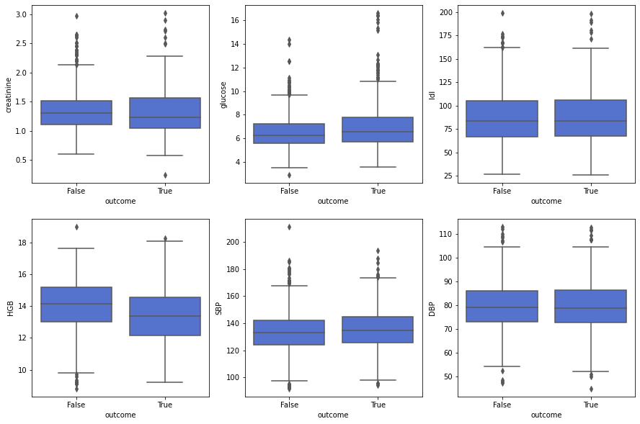
Bivariate analysis: biomarkers ~ CKD progress

Slide 17
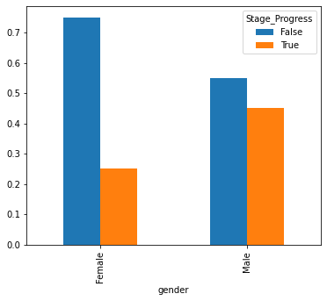
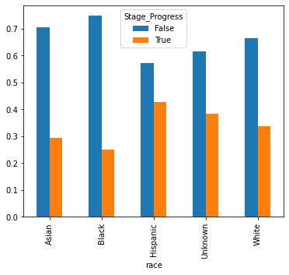
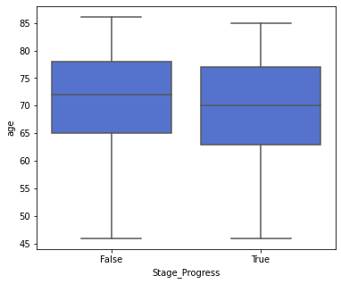
Stage progress ~ demographics

Slide 18
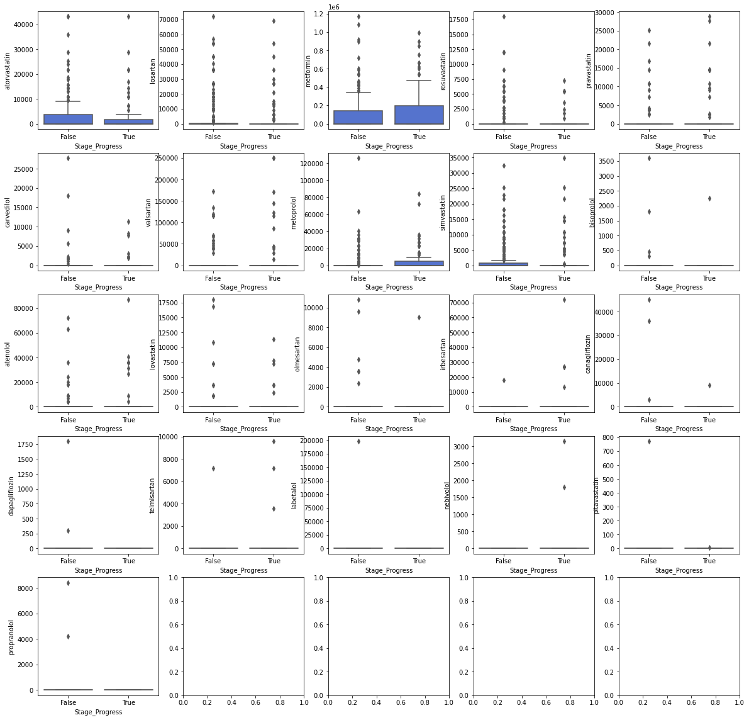
Medications ~ CKD progress
The use of only 4 drugs was significantly different between groups:
pravastatin
metoprolol
irbesartan
nebivolol

Slide 19
Analysis and modeling
Prediction modeling and performance evaluation

Slide 20
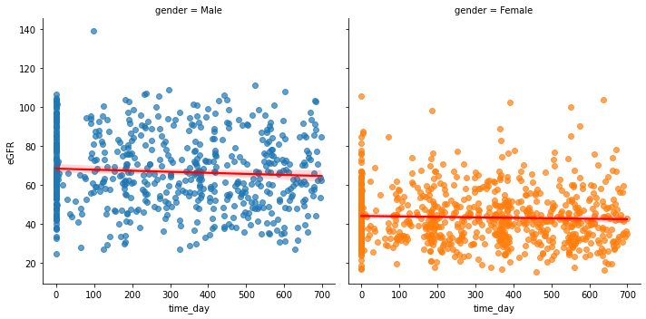
“Evidence-based” approach to predicative modeling
Estimated Glomerular Filtration Rate (eGFR) ~ time & gender
Notes:
Contrary to algorithm-based approach which replicate a chain of procedures in order to train a model and then evaluate its performance.

Slide 21
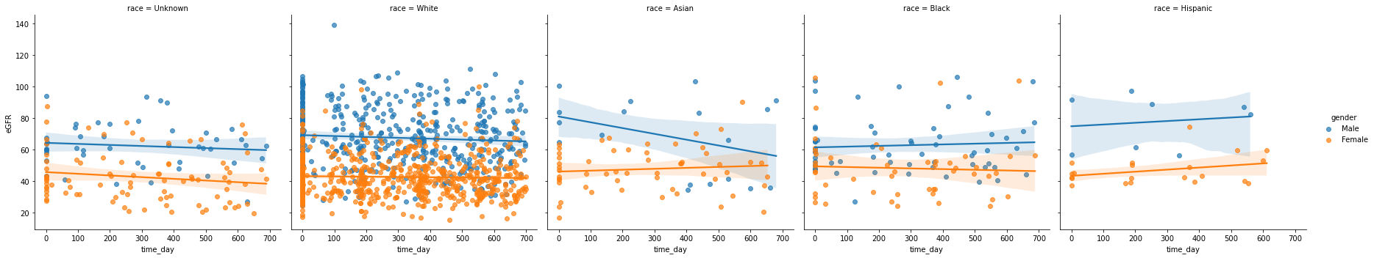
eGFR ~ time & race

Slide 22
Handling repeated measures data (biomarkers time series)
Repeated measures (time-series domain) is transformed into scalar estimates obtained via fitting mixed-effect (multilevel) linear models and/or multiple individual linear model with samples from single subject

Slide 23
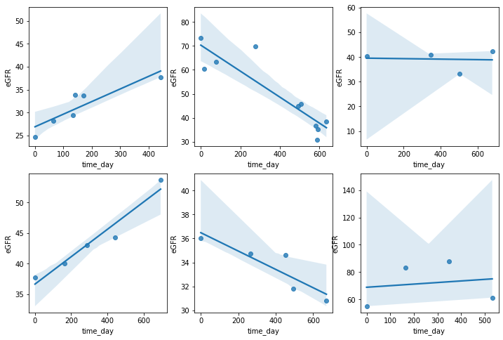
Compute individual features of eGFR ~ time relationship
Mixed Effect (multilevel/hierarchical) Liner Regression was used to estimate individual coefficients for intercept and slope of time–eGRF relationship.
These coefficients determine an extrapolated trend of CKD progression and will be used as features in prediction modeling

Slide 24
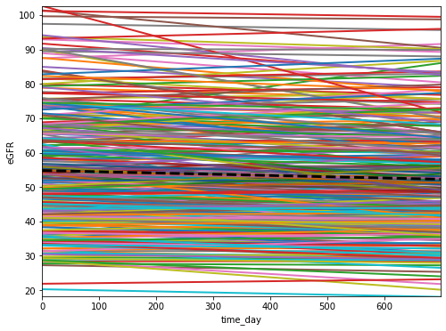
Individual linear projections

Slide 25
CKD progression prediction model
Stage progression = eGFR linear estimates [intercept, slope, p-value, R2]
+ biomarker linear estimates [intercept, slope, p-value, R2]
{creatinine + glucose + HGB + SBP + DBP + LDL}
+ biomarkers [last value and mean]
{creatinine + glucose + HGB + SBP + DBP + LDL}
+ health risk factors [categorical binary]
{Diabetes + Anemia + Hypertension + Dyslipidemia + Medications}
+ demographics
{age, gender}

Slide 26
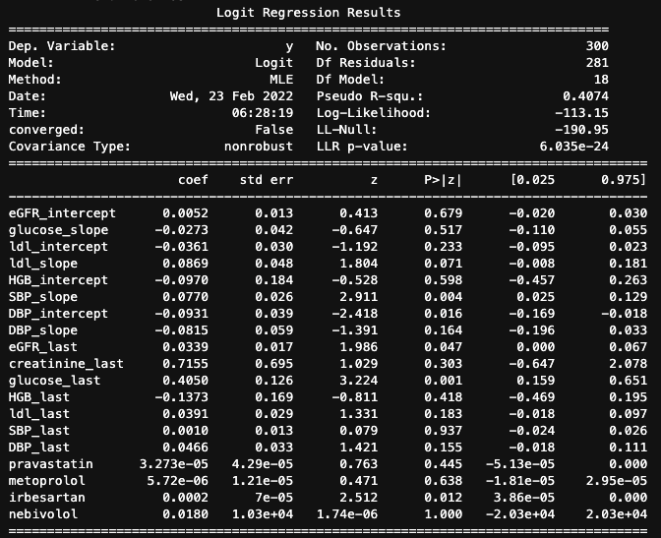
Fitting logistic regression: parsimonious model results
Note goodness-of-fit measure:
Pseudo-R-squared = 0.407
(quite good!)
Notes:
Model with statistically selected biomarker-features (KS test p-value < 0.05)

Slide 27
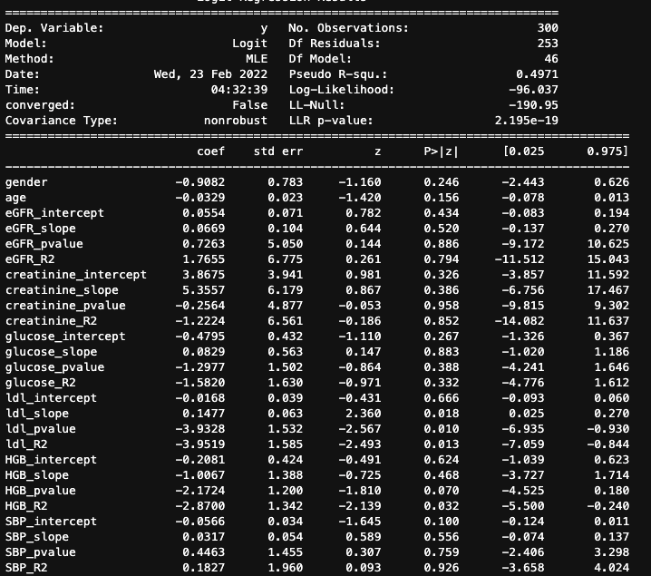
Fitting logistic regression: full model results
Note goodness-of-fit measure:
Pseudo-R-squared = 0.479
(better!)

Slide 28
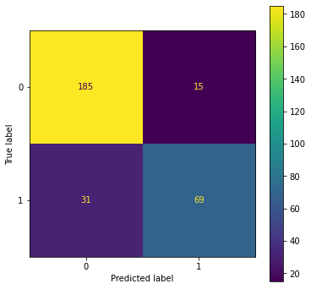
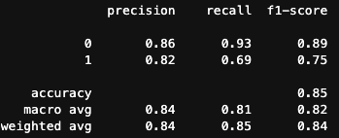
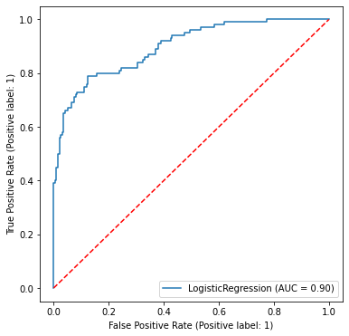
Prediction modeling with logistic regression
Performance evaluation on the entire sample as training set
Performance evaluation with repeated k-fold cross-validation (4 folds, 5 repeats) using perditions from hold-out folds
Metrics | Mean (SD)
F1 score | 0.762 (0.043)
Recall (sensitivity) | 0.637 (0.074)
AUC-ROC | 0.834 (0.042)

Slide 29
Further research and modeling ideas
Mixed-effect logistic regression (repeated measures in independent variables)
Bayesian logistic regression and probability estimation using Markov chain Monte Carlo methods

